Slide 1
Multiplication Rule for Exponents
Integrated Mathematics

Slide 2
Objective
Students will apply the multiplication rules of exponents to calculate the product of two or three mathematical terms.

Slide 3
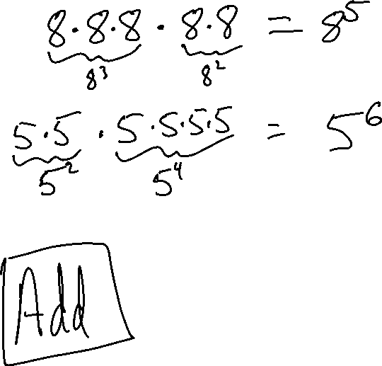
Multiplying Using Exponents
8³ • 8² means
5² • 5⁴ means
What did we do with the exponents?

Slide 4
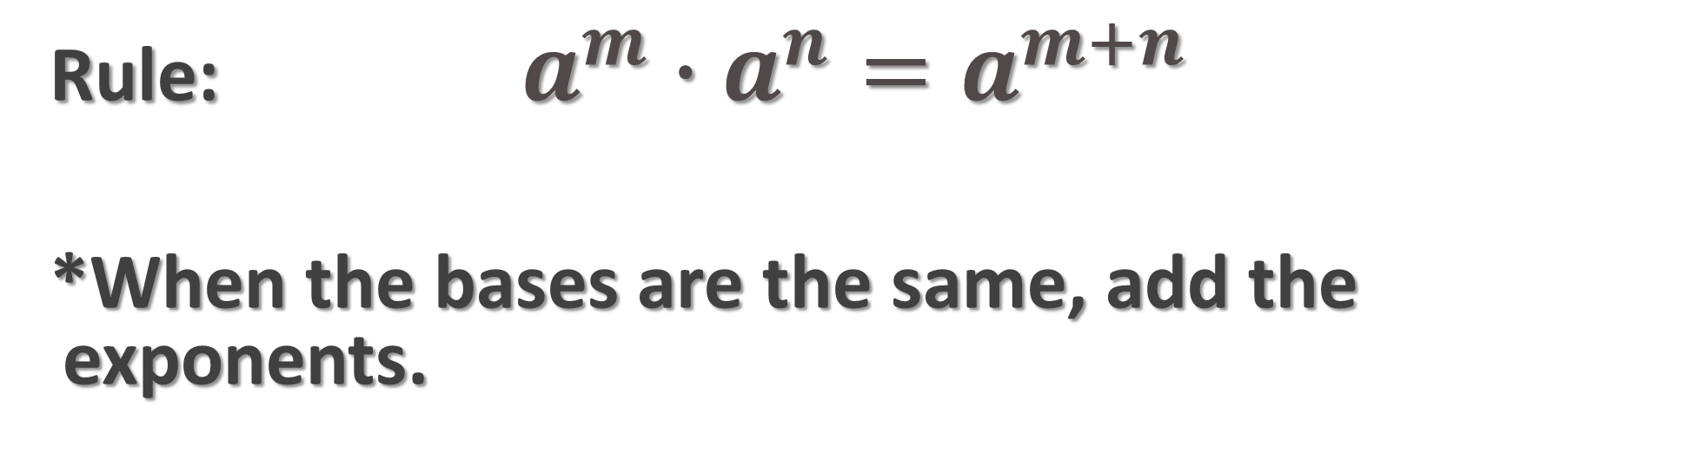
Multiplying Using Exponents
Rule:$a^{m}∙a^{n}=a^{m+n}$
*When the bases are the same, add the exponents.

Slide 5
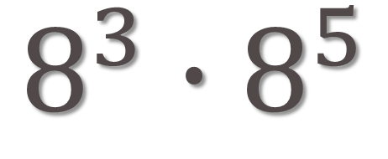
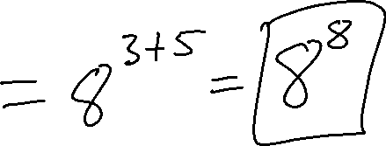
Example 1
$$8^{3}∙8^{5}$$

Slide 6
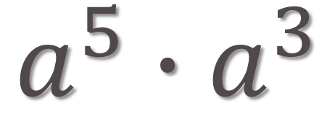
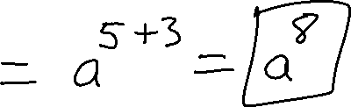
Example 2
$$a^{5}∙a^{3}$$

Slide 7
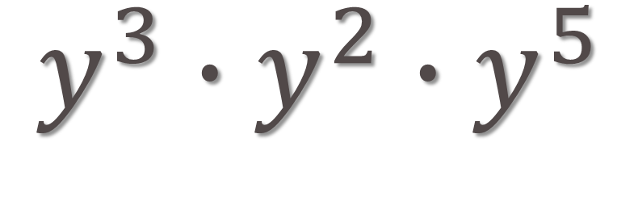
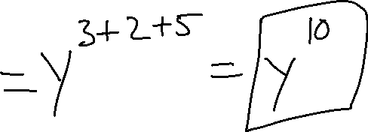
Example 3
$$y^{3}∙y^{2}∙y^{5}$$

Slide 8
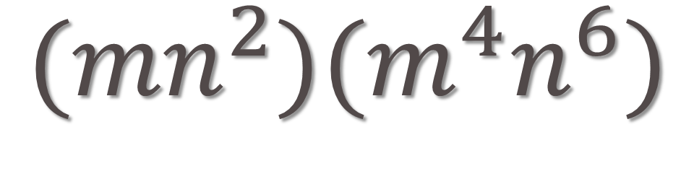
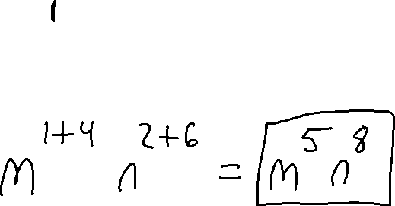
Example 4
$$({mn}^{2})(m^{4}n^{6})$$

Slide 9
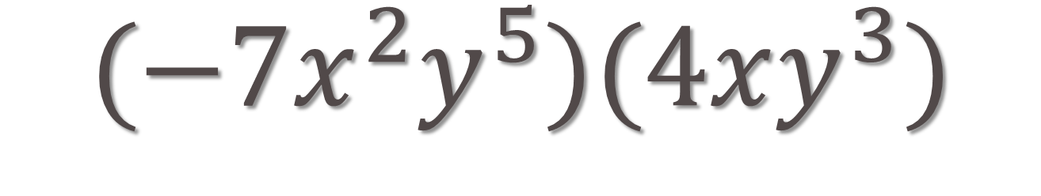
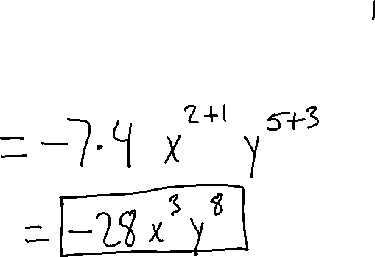
Example 5
$$({−7x}^{2}y^{5})(4xy^{3})$$

Slide 10
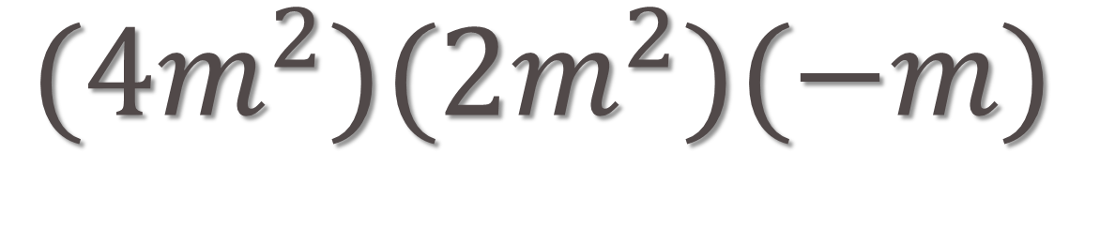
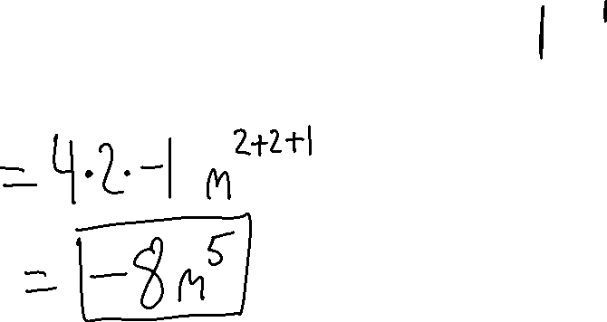
Example 6
$({4m}^{2})(2m^{2})(−m)$

Slide 11
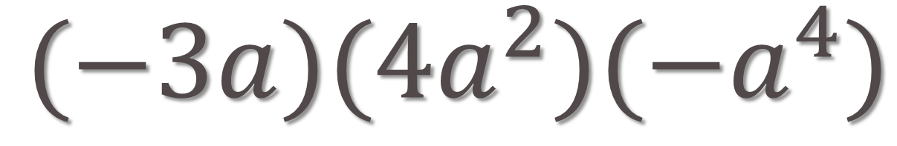
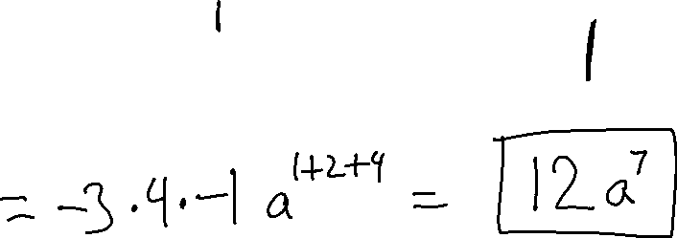
Example 7
$(−3a)(4a^{2})(−a^{4})$

Slide 12
TRY THESE
2 • 2⁵
g² • g³
9ng⁶ • 6n³g⁴
6b²h³ • 3bh⁶
k⁶g² • 6k⁴g⁵ • 3kg⁴
6z³ • 5z⁵ • 9z²

